Slide 1
MQTT Topic
Topic1(DO開關):esp32/len
Topic2(DO狀態):esp32/len/receive
Topic3(DI狀態):esp32/len/alarm
CHT
internet
core1
MQTT 伺服器
broker.mqttgo.io
MQTT
2.4G WiFi
手機 MQTT APP
2.4G WiFi
AP 路由器
core1
MQTT
WiFi 連線
DI
開關
ESP32
DO
110V/10A
5V Relay
core0
core0
DC 5V
adapter
110V/60HZ

Slide 2
DI
OLED
ST7789
RS-485
MODULE
A
B
I2C
ESP32 D1 mini
GND
NC
AC 125V/15A
DC 5V RELAY
COM
5V
NO
USB CABLE

Slide 3
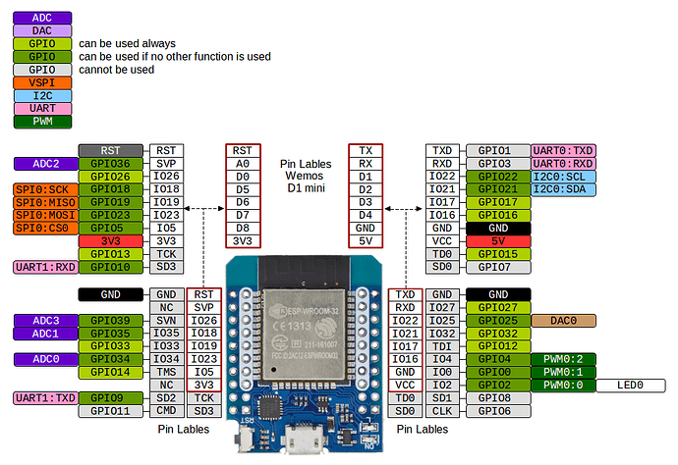

Slide 4
接腳(I/O) | 功 能 | 接腳(I/O) | 功 能
1(3V3) | 3.3V供電 | 38(GND) | GND接地
2(EN) I/P | 高電平晶片使能。(/RESET = LOW) | 37(23) | VMOSI,HS1_STROBE
3(36) I/P | ADC1_CH0,SENSOR_VP,RTC_GPIO0 | 36(22) | SCL,VSPIWP,U0RTS,EMAC_TXD1
4(39) I/P | ADC1_CH3,SENSOR_VN,RTC_GPIO3 | 35(1) | U0TXD,CLK_OUT3,EMAC_RXD2
5(34) I/P | ADC1_CH6,RTC_GPIO4 | 34(3) | U0RXD,CLK_OUT2
6(35) I/P | ADC1_CH7,RTC_GPIO5 | 33(21) | SDA,VSPIHD,EMAC_TX_EN
7(33) | ADC1_CH4,TOUCH9,XTAL_P(32.768kHz input),RTC_GPIO9 | 32(GND) | GND接地
8(32) | ADC1_CH5,TOUCH8,XTAL_N(32.768kHz output),RTC_GPIO8 | 31(19) | VMISO,U0CTS,EMAC_TXD0
9(25) | DAC_1,ADC2_CH8,RTC_GPIO6,EMAC_RXD0 | 30(18) | VSCLK,HS1_DATA7
10(26) | DAC_2,ADC2_CH9,RTC_GPIO7,EMAC_RXD1 | 29(5) | VSS,HS1_DATA6,EMAC_RX_CLK
11(27) | ADC2_CH7,TOUCH7,RTC_GPIO17,EMAC_RX_DV | 28(17) | U2TXD,HS1_DATA5,EMAC_CLK_OUT_180
12(14) | HSCLK,ADC2_CH6,TOUCH6,MTMS,RTC_GPIO16,HS2_CLK,SD_CLK,EMAC_TXD2 | 27(16) | U2RXD,HS1_DATA4,EMAC_CLK_OUT
13(12) | HMISO,ADC2_CH5,TOUCH5,MTDI,RTC_GPIO15,HS2_DATA2,SD_DATA2,EMAC_TXD3 | 26(4) | ADC2_CH0,TOUCH0,HS2_DATA1,RTC_GPIO10,HSPIHD,EMAC_TX_ER
14(GND) | GND接地 | 25(0)(UP) | ADC2_CH1,TOUCH1,RTC_GPIO11,CLK_OUT1,EMAC_TX_CLK
15(13) | HMOSI,ADC2_CH4,TOUCH4,MTCK,RTC_GPIO14,HS2_DATA3,SD_DATA3,EMAC_RX_ER | 24(2)(LED) | ADC2_CH2,TOUCH2,HS2_DATA0,HSPIWP,RTC_GPIO12,HS2_DATA0
16(9) | SD_DATA2,U1RXD,SHD/SD2,SPIHD,HS1_DATA2 | 23(15) | HSS,ADC2_CH3,TOUCH3,MTDO,RTC_GPIO13,HS2_CMD,SD_CMD,EMAC_RXD3
17(10) | SD_DATA3,U1TXD,SPIWP,HS1_DATA3 | 22(8) | SD_DATA1,SPID,HS1_DATA1,U2CTS
18(11) | SD_CMD,SPICS0,SCS/CMD,HS1_CMD,U1RTS | 21(7) | SD_DATA0,SPIQ,HS1_DATA0,U2RTS
19(5V) | 5V 電源 | 20(6) | SD_CLK,SPICLK,SCK/CLK,HS1_CLK,U1CTS

Slide 5
DI | ESP32 D1 mini
IN | pin32
GND | GND
IN | pin33
GND | GND
I2C | ESP32 D1 mini
SDA | pin21(SDA)
SCL | pin22(SCL)
POWER | ESP32 D1 mini
USB DC 5V | VCC
GND | GND
Relay | ESP32 D1 mini
IN | pin4
VCC | 3.3V
GND | GND
RS-485 | ESP32 D1 mini
DI(TX) | pin17(TX)
R0(RX) | pin16(RX)
DE、RE(短路) | pin14
VCC | 3.3V
GND | GND
ST7789 OLED(SPI) | ESP32 D1 mini
GND | GND
VCC | 3.3V
SCL | pin18(VSCLK)
SDA | pin23(VMOSI)
RES | pin0
DC | pin19(VMISO)
CS | pin5(VSS)
BLK | pin15

